Slide 1
Cork Sec Talk
Hello and Welcome

Slide 2
Format of the talk
Quick introduction of myself.
How I got into security.
What I like about Cork Sec.
Malware Analysis: TrickBot Banking Trojan

Slide 3

Hello!
My name is Geoff O’Rourke
Going into 4th year BSc in IT Management in C.I.T
Have always been in interested in security.
Only working in the industry for 6 months with Cylance.
Attended my first Cork Sec only December last year.
This is my first talk here!

Slide 4
How I got into cyber-security?
Was always into computers, video games and technology.
About 10 years ago my friends family computer became infected and was compromised
Leading to his parents banking details being stolen.
Since, I have been interested in the topic.
Find advances in the security industry fascinating in recent years.
Online breaches could lead to millions being effected.
Potential billions of revenue lost.
Global shutdowns of major services can happen.

Slide 5
Why Security?
Super fast paced and ever evolving.
Complexity of malware only advancing further.
The amount of malware is only growing.
The potential damage from malware is only growing.
One weakness can lead to a massive exploit.
One needs to be constantly learning in this business.
Growing market and it’s importance's is priority now.

Slide 6
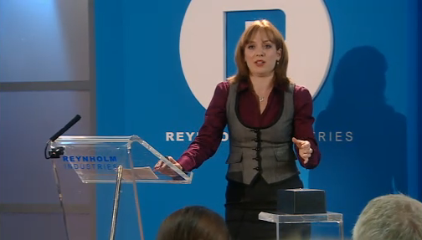
IT Management (ITM)
Started studying in CIT in 2014.
Broad course focused on networking, security and basic coding.
Recent restructure makes it even more security orientated.
Group project and placement in 3rd year.
Main project done in 4th year of students choosing.
“Ladies and gentlemen, I’d like to present to you – the Internet!“

Slide 7
Career path so far…
Generic part-time job
Generic part-time job (but in green)
Cylance internship

Slide 8
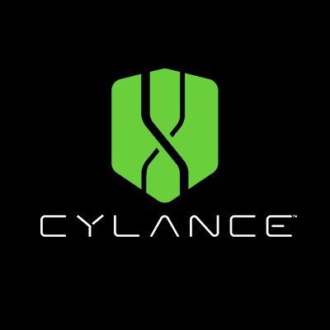
Internship
Working as a Threat Research (TR) intern in Cylance.
Started as a mandatory 3 month placement.
Given extension for a further 6 months.
Have learned a lot and developed new skills.
First full time professional job,
Big step up from part-time retail.

Slide 9
My job
Intense training, learned the ropes fast.
Constantly dealing with large data sets.
Data management is vital.
Core understanding of various programming languages.
Core grasp of networking is needed.
Main role:
Successfully inspecting files and classifying them correctly based off its capabilities and features.
A security job is more than a job, it’s a lifestyle and a willingness to learn and progress is critical to development .

Slide 10
Analysis
How I look at file as a Threat Researcher

Slide 11
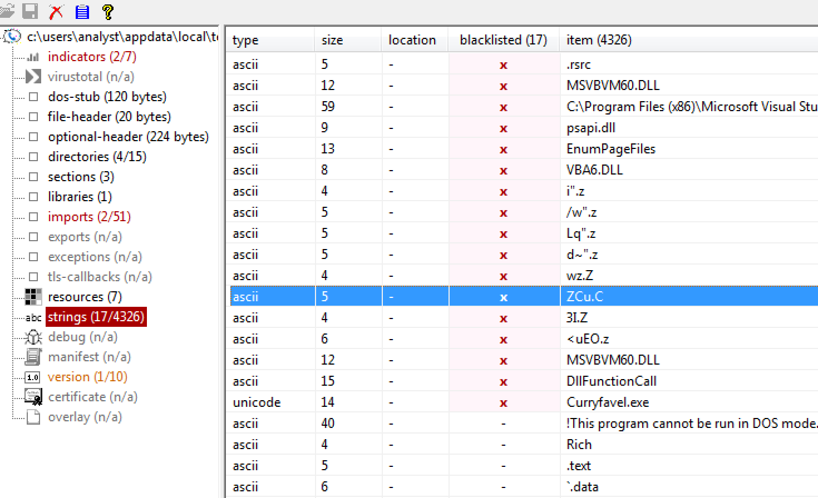
Static Analysis
What is Static Analysis?
Analysis of a file pre-execution.
What type of language a file is created in.
Is it packed?
Here we can inspect strings, imports and a sections of a file
Gain an insight into it.
Tools like:
PeStudio (like shown)
FileAlyzer
CFF Explorer.

Slide 12

Dynamic Analysis
What is Dynamic Analysis?
This is analyzing a file once detonated.
Get true intent of a file be it malicious or benign.
See if a legit looking file from static analysis is a trojan.
Malicious looking file is simply potentially unwanted.
Tools like:
Procmon
Buster Sandbox
RegShot.

Slide 13

Cuckoo Analysis
What is Cuckoo?
Cuckoo is an open source automated malware analysis system.
Runs files in a sandbox analyzing what it does.
It can:
Trace API calls.
Dump network traffic.
See how it interacts with the device.
At the end of analysis it gives a score.
Its free!

Slide 14
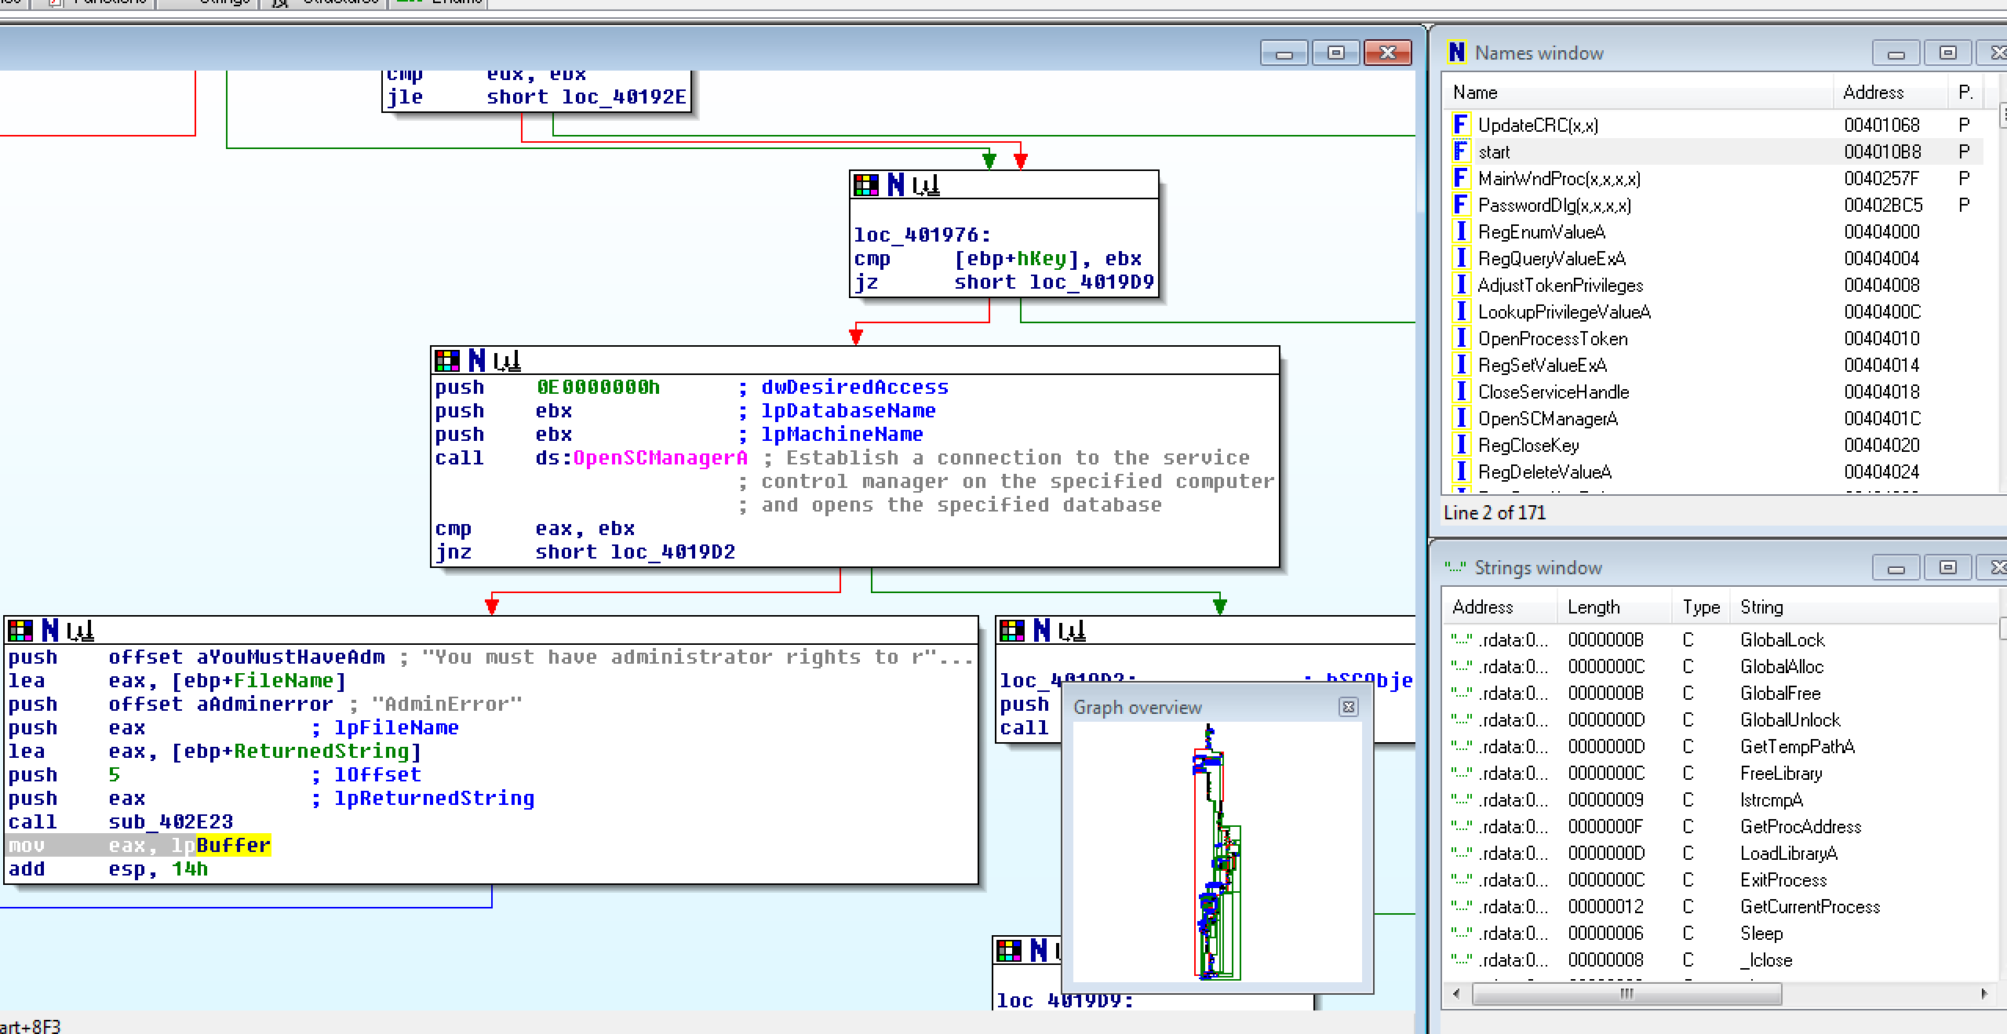
IDA (Interactive Disassembler) Analysis
Used to unpack files with debugger
Get a greater understanding of a file.
More complex piece of analysis.
Graphical representation of files and how they work.
Extremely useful in finding capabilities of a file.
Can be a bit overwhelming sometimes
Not used on ALL files.

Slide 15
Virus Total
Free service
Can inspect files and show what different vendors are saying about it.
Can be used to check URL’s.
Premium version of the service called ’Intelligence’
One can search hundreds of SHA256’s and Hashes at once.
Create Yara rules and signatures and ‘retro hunt’ malware.
’Graph Mode’ used to visually inspect:
API calls.
Connected URL’s.
Other files a sample might be trying to connect to.
Overall an extremely useful service in my role.

Slide 16
Cork Sec
And why I have been standing here talking…

Slide 17
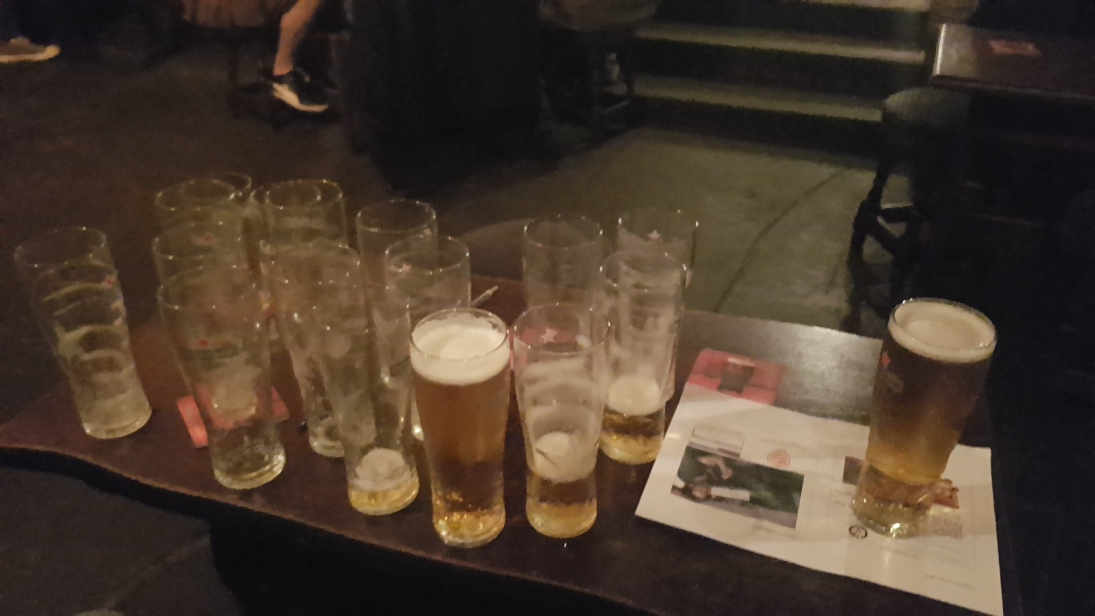
Why I like Cork Sec
A community based off one of my interests.
A group of different skill levels
Different roles in and outside of the industry.
Diverse community of age.
Have learned something new every time I have gone.
Have made friends and peers in and out of the security field here.
Open forum for anyone
(even for me!)

Slide 18
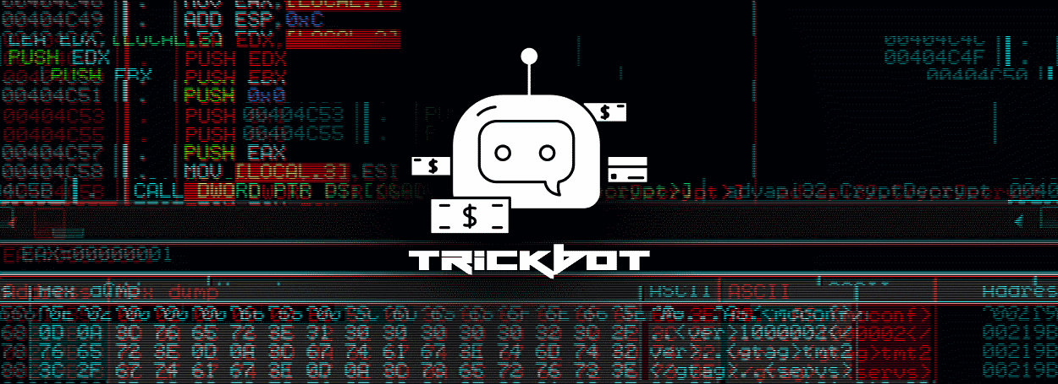
Notes:
Hey guys so today I'm going to talk about a modular piece of malware called Trickbot.
Its a bot-net piece of malware with focus on being a banking trojan
What I found interesting about this is it is fully modular and pulls different modules from its C2 server.

Slide 19
Banking Botnet Money stream
Botnet
DDoS
Spam
Install Adware/Malware
Phishing
Steal information
Selling bank accounts information
Selling Internet services and shop accounts
Selling identity information
Emptying bank accounts

Slide 20
Brief Introduction
In the wild since 2016.
Similar to Dridex and Dyre Trojan, same threat actors?
Uses man-in-the-middle attacks on users visiting banking websites.
It then falsifies the appearance of these banking sites using webinjects.
Leads to it’s victims to input there sensitive details into the phony sites
Thus leading there accounts compromised.
In 2017, Malware started to target the UK and the rest of Europe.
Since it’s introduction the malware has been developing.
A partnership has formed between it and another damaging Banking Trojan.
Notes:
- So it was first seen in the wild about 2016.
- Its code and capabilities are similar to Dridex and Dyre, some online claim they are the same threat actors.
- Users are directed to phony but extremely legit looking fake banking sites instead of the real ones after being hacked.
- In 2017 it started focus on us in the UK and Europe
- What made me interested in this malware actually can pull down a new module which has been in the wild only since late March.
- Suggesting the malware is still growing and developing.
- This new module gives the malware the ability to lock a users screen. Maybe leading to it become Ransomware like in the next few months.

Slide 21
Brief Overview
Main Sample (packed)
SHA256 | 10c3311edfe849b456814940915de9d3a87735651a368c381ffaaff776289935
Size | 463.0 KB
Type | Win32
VT Hits | 52/66
Downloaded Modules | Hashes
systeminfo32.dll | 711287e1bd88deacda048424128bdfaf
injectDll32.dll | 58615f97d28c0848c140d5e78ffb2add
wormDll32.dll | 30fc6b88d781e52f543edbe36f1ad03b
shareDll32.dll | 5be0737a49d54345643c8bd0d5b0a79f
importDll32.dll | 88384ba81a89f8000a124189ed69af5c
mailsearcher32.dll | 3def0db658d9a0ab5b98bb3c5617afa3
tabDll32.dll | 311fdc24ce8dd700f951a628b805b5e5
Hashes taken from Webroot TrickBot article
Notes:
So this main sample wasn't found in my distro. A file similar was found in distro which got hits off trickbot but used this found by Webroot as my main sample instead.
So, I had a look online and found that Webroot had released the hashes for the malware itself but also its modules it can download.
I found this pretty awesome as I could analyze both the main file and the files it can download from the c2 server.
I'm going to talk further about tabDll32 a it's only in the wild about 2 months.
Just of note as I don't dive into it the wormdll32 is actually ripped from WannaCry and NotPetya to increase the spread of the malware. That was seen in the wild about a year ago

Slide 22
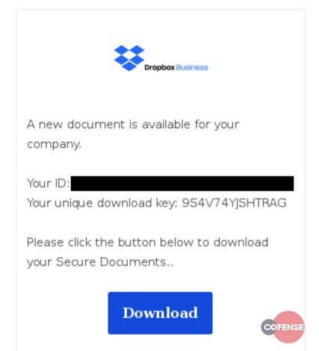
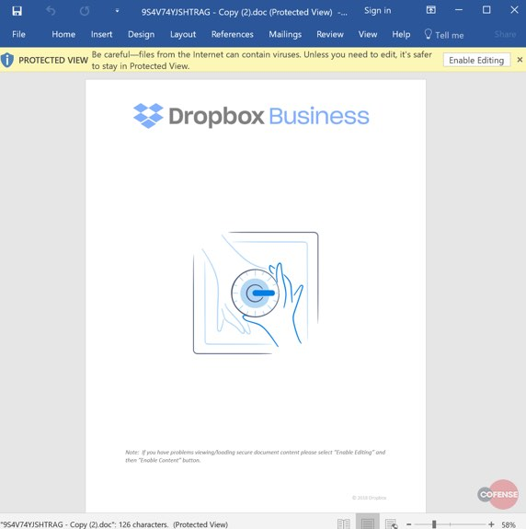
Email Spam
Notes:
The majority of attack is through Email Spam from legit companies like this dropbox example
I found this drop box spam email off Co-fense.
I have also seen ones from the Bank of Scotland etc.
We see once you download the "secure" document we get this generic document with it asking to leave protected view.
Disabling this runs the macro and drops the malware

Slide 23
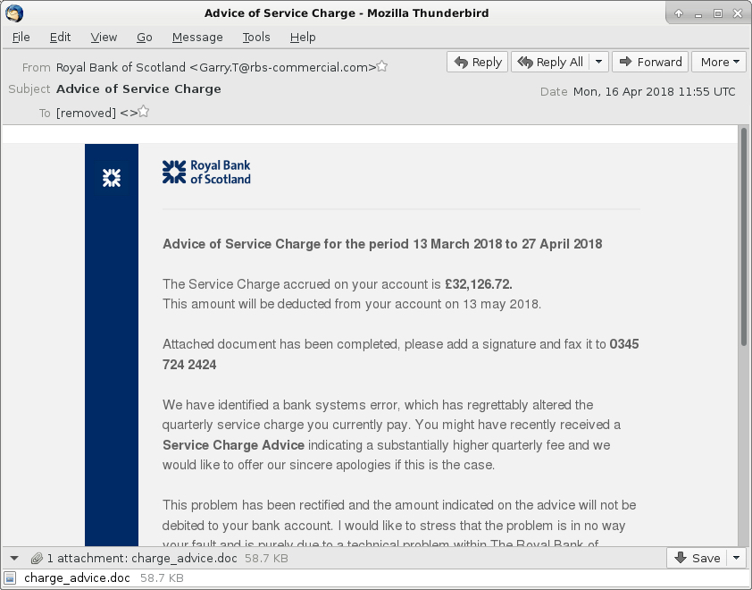
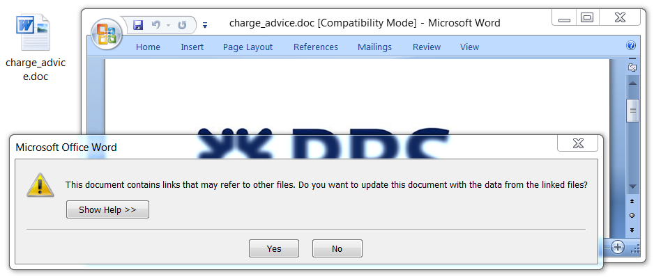
Email Spam continued..

Slide 24
Source: IBM X-Force

Slide 25
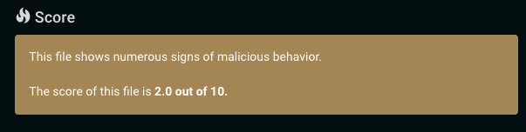
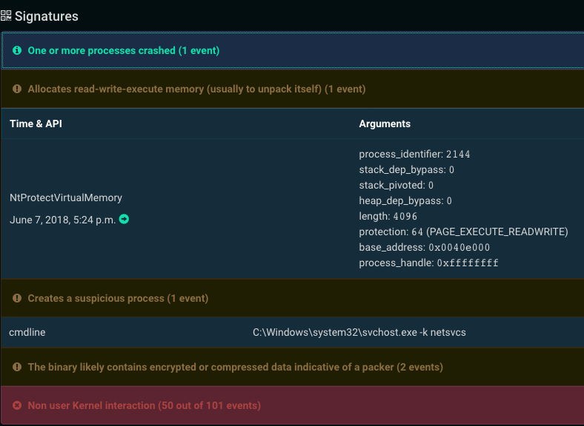
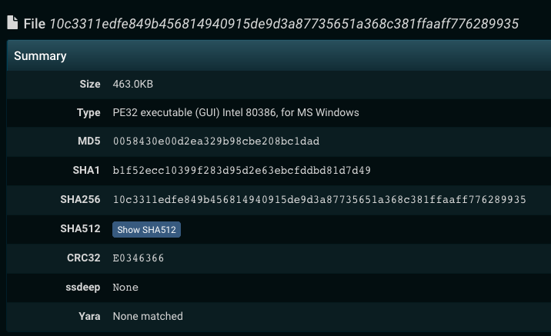
Cuckoo Analysis
Notes:
So I was pretty under- whelmed but not surprised with the results from Cuckoo....
Individually all modules get about a 2 in cuckoo score each as on there own they don't do much.
The one thing of note from Cuckoo is its injection into Svchost this will come into place when we run the file in dynamic analysis as it utilizes process hollowing

Slide 26
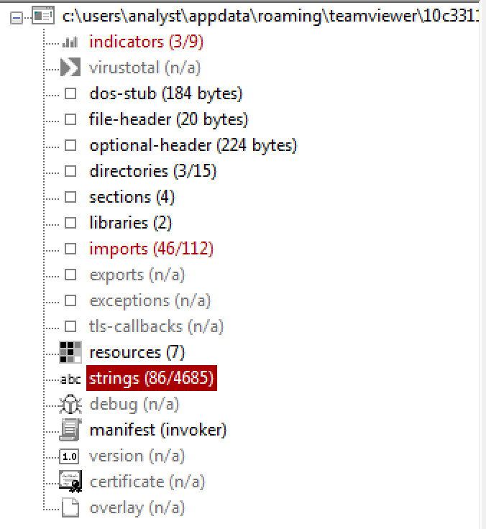
Static Analysis – Main File
The file is packed by its own custom packer
A lot of blacklisted imports
Only 86 blacklisted strings
A lot of string references to countries.
Overall not a lot of information due to it’s packed nature.
The file really needs to be executed to reveal its true intentions.
Notes:
So like I expected I didn't get much from the main .exe
The file seems to be pack
Does have a lot of blacklisted imports
But in both PeStudio and FileAnalzer I had trouble getting much information from it.
Other then a few strings that malware generally uses and a vast amount of nation references I overall couldn't do much with this sample.
What I find did kind of cool from this sample is that because it's fully modular it depends greatly on it's modules

Slide 27
Dynamic Analysis
Post execution
Notes:
So with this revelation I moved onto dynamic analysis.
I detonated the malware but without connection to online the malware doesn't pull the modules from its c2. That's ok though I downloaded them myself.

Slide 28
Execution
Infection happens through weaponized Word documents from banks/services with embed macros (as shown earlier)
Macro dropped into the %APPDATA% folder and executed.
Uses process hollowing to insert itself into SVCHost.exe
Creates scheduled tasks on the system for persistence.
Tests internet connectivity.
Uses Transport Layer Security as communication, but not always on Port 443
Once successful it connects to its C2 server.
Malware then pulls modules and updates.
Modules collect information off the system and browsing credentials, mostly focusing on online banking.
Notes:
So as stated earlier the execution happens through the spread of infected word docs downloaded from infected emails.
Once downloaded it executed
- Creates a lot of scheduled tasks on the system.
- Through process hollowing it inserts itself into SVCHost.
- Creates client_id and group_tag files and a folder called modules.
- The malware tests connection to online
- Once successful it connects to a C2.
- Once connected to a server it can pull modules and updates.
- It can also inject itself into modules found on your device that collect information and online credentials.

Slide 29
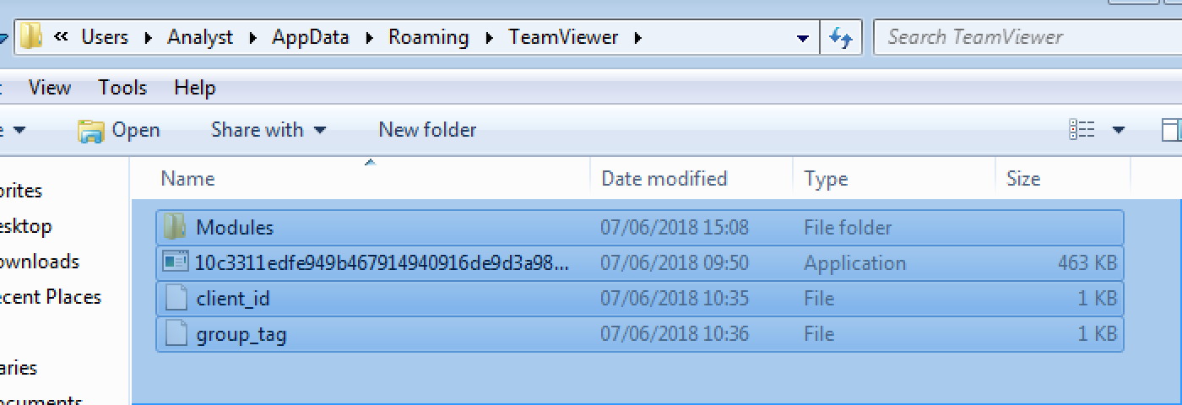
Payload
Once the malware is ran it copies itself to :
%AppData%/Roaming/Teamviewer
(Not always)
Drops :
Module folder
Client_id
Group_Tag
Once internet connection is made it also drops :
Config.conf
Notes:
So this is the payload of the macro in the word document.
It copies itself to this Roaming folder of Team Viewer.
We see from my own device it drops Modules folder which is empty.
- The malware copy of itself
- The client ID file is basic information about the user and device.
- I'm not 100% sure what the group tag is references for.
- My only problem with the execution and dropping of its payload is the malware tests for internet connection before dropping the last file called Config.conf
Sadly wireshark nor fakenet or even in Cuckoo would make the malware drop this file....

Slide 30
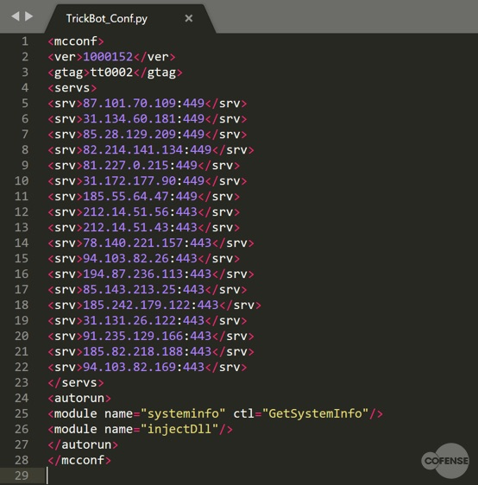
C2 Infrastructure
This is the file: Config.conf
This is an AES encrypted file
Decrypter online freely available on GitHub.
I didn’t let the malware online.
So I couldn’t unlock it myself.
Upon running the decrypter it shows you the full extent of the C2 infrastructure.
Cofense utilizing the decryter
Notes:
So this is why I wanted the malware to drop Config.conf as it actually has the C2 infrastructure which I found pretty cool.
- This file is normally AES encrypted but someone released a decryptor for it, revealing the full extent of the c2's involved in the malware.
- As it never dropped for myself I pulled this image of the decyptor at work. Once its ran successfully it unlocks itself.
- And ta da! A lovely list of C2 servers.
- Due to time, I didn't dive into these much but found this cool. I know a lot of these are bases in Russia, Poland and Eastern Europe.

Slide 31
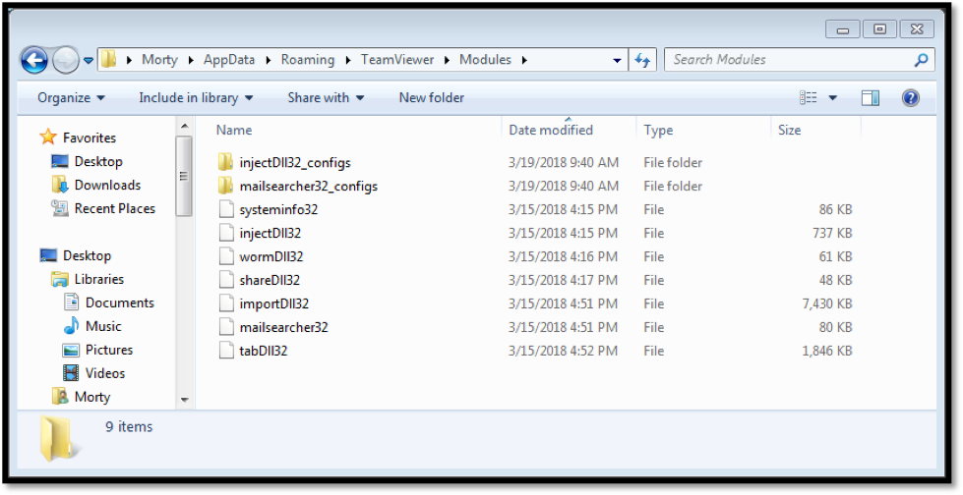
Downloaded Modules
Connection is made to the C2 servers
The malware drops its modules.
Because these are modular it can avoid detection.
Makes updating the malware easier.
Makes development of new modules easier also.
All the modules have different roles and functions.
For each component of TrickBot running there is an corresponding instance of svchost.exe

Slide 32
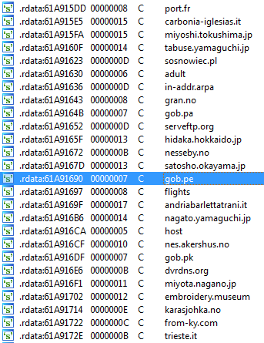
InjectDll32.dll
Main module which stores all scripts.
A lot of its data is hardcoded.
Hardcoded references from different websites from varies countries :
France
Japan
Italy
UK
URL’s used to steal information off them.

Slide 33
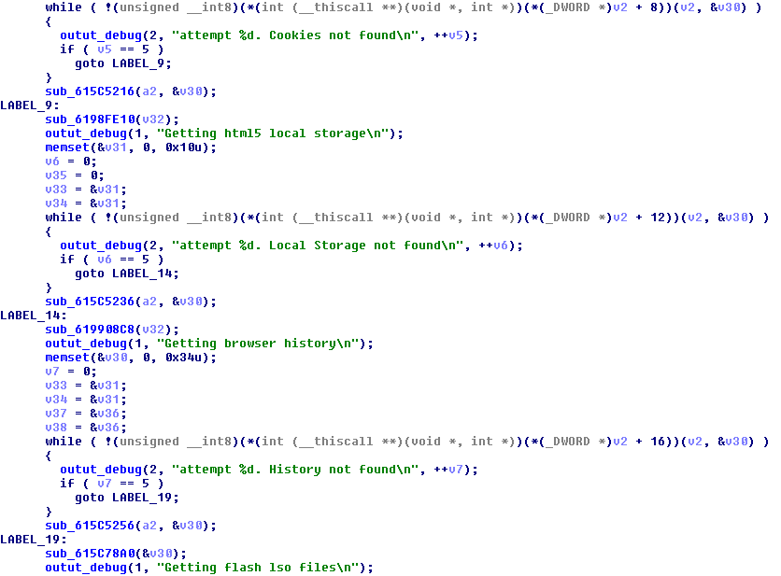
ImportDll32.dll
Dropped early 2017
Used to steal :
Cookies
HTML5 Local Storge
Browser History
URL hits
Not obfuscated and rather easy to see modules true intentions.

Slide 34
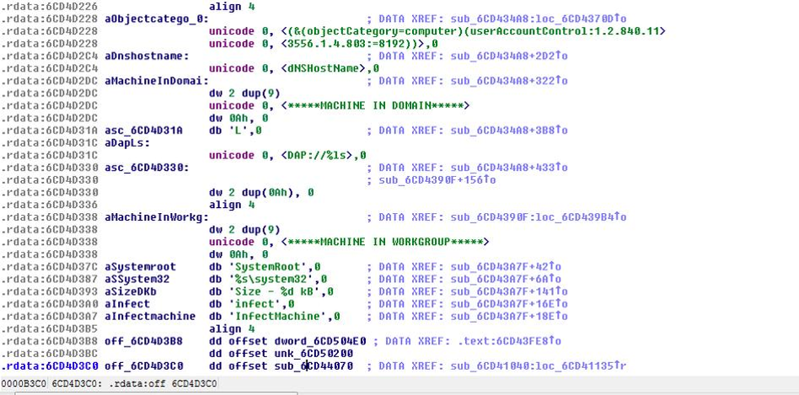
Wormdll32.dll
Dropped mid 2017
Self replicating worm module.
Uses similar method to WannaCry and NotPetya strains.
Uses Server Message Block (SMB) vulnerability in Windows
Spreads via Lightweight Directory Access Protocol (LDAP).
But doesn’t fully replicate the lethality of WannaCry.

Slide 35
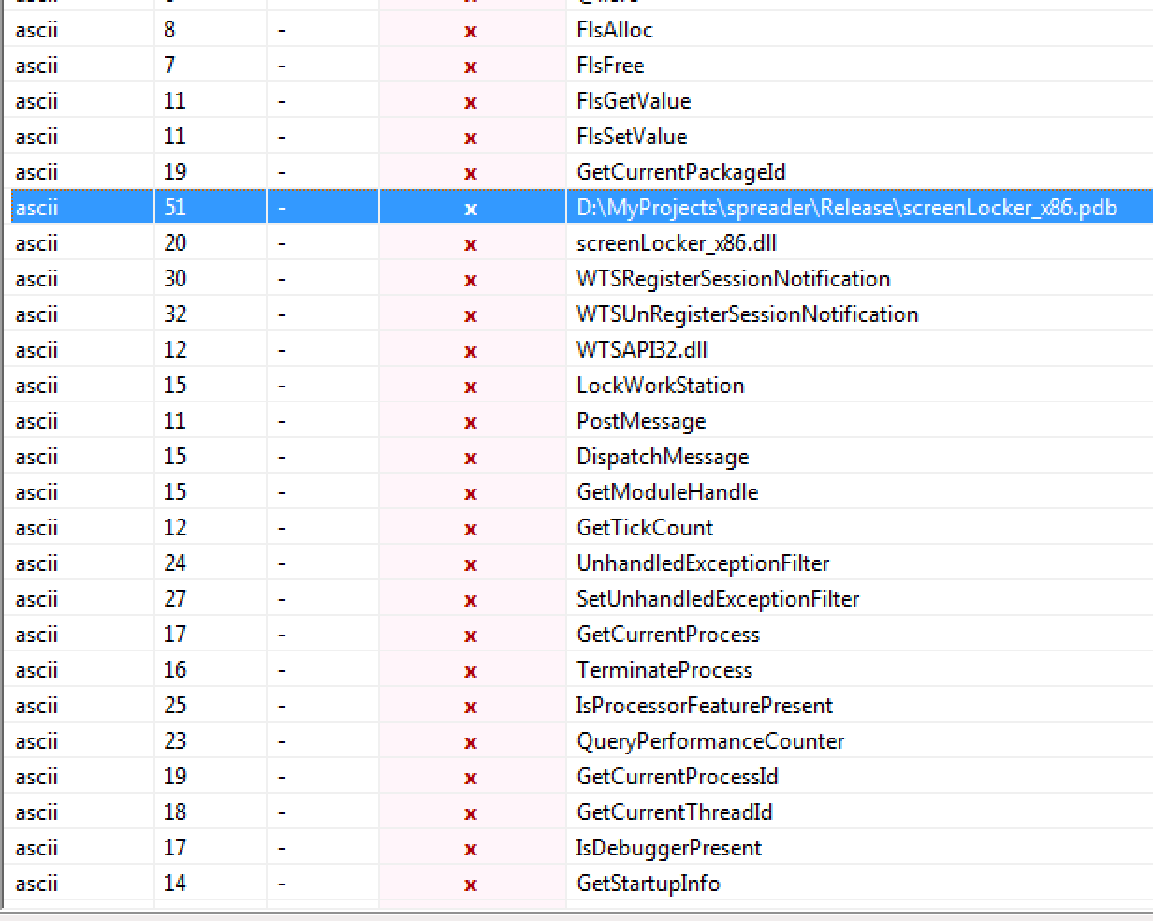
Tabdll32.dll
Initially feared to be a ransom module making the malware a dual threat.
Recent versions leverage Mimikatz to steal WDigest credentials.
But Microsoft protects WDigest credentials under a registry key.
TrickBot flips this registry key to enable WDigest.
TrickBot's screenlocker module comes into play, as the user must re-log into his account after WDigest support is enabled.

Slide 36
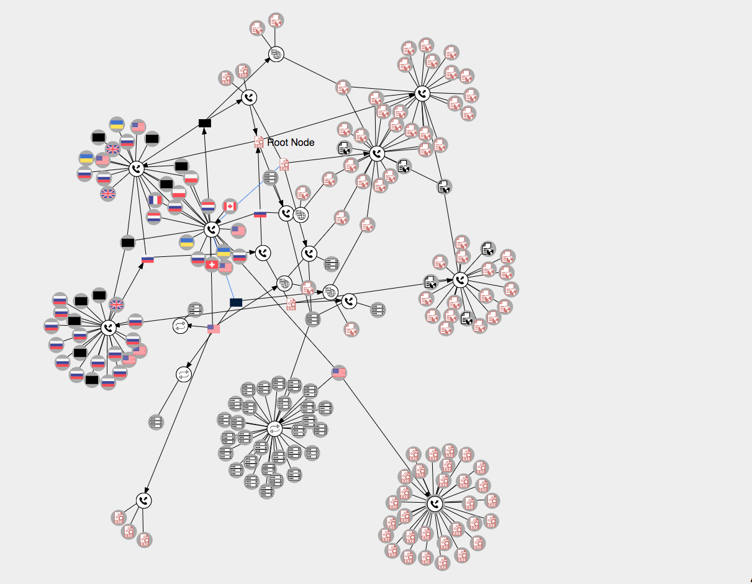
Virus Total Graphs
So this is Virus Total Graphs as explained earlier…
Extremely useful dealing with Botnets, Worms and Downloaders.
Visual representation of a files:
API calls
URL’s it connects to
Visualizes the extent of file.
Complex malware like this tend to have vast webs of information.
This was less then 10% of the samples diagram…
Notes:
So I threw the main file into VT graph hoping for some C2 server information back.. Instead I got this mess back.
This isn't even the full picture by the way with this being less then 10% of the possible expend from what I toyed around with.

Slide 37
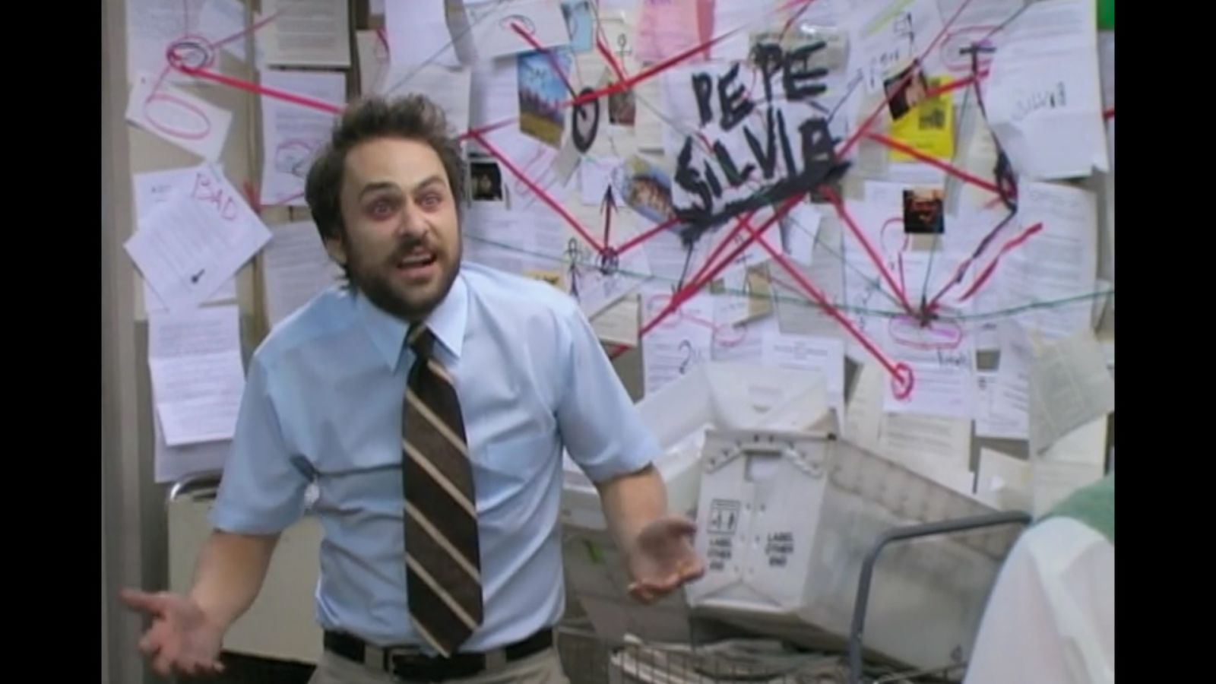
Me looking at VT Graphs of TrickBot

Slide 38
IcedID – Malware Banking Trojan
IcedID in the wild since late 2017.
Holds about 3% of Banking Trojans 2018
Use’s a modular approach with its malicious code.
Targets banks, mobile service providers, payroll and e-commerce sites.
Can leverage the Emotet Trojan to be distributed.
Once on a system, it can self propagate.
It can monitor victims by setting up a local proxy for traffic tunneling.
Uses webinjects and redirection attacks like TrickBot.
But why am I telling you this?

Slide 39
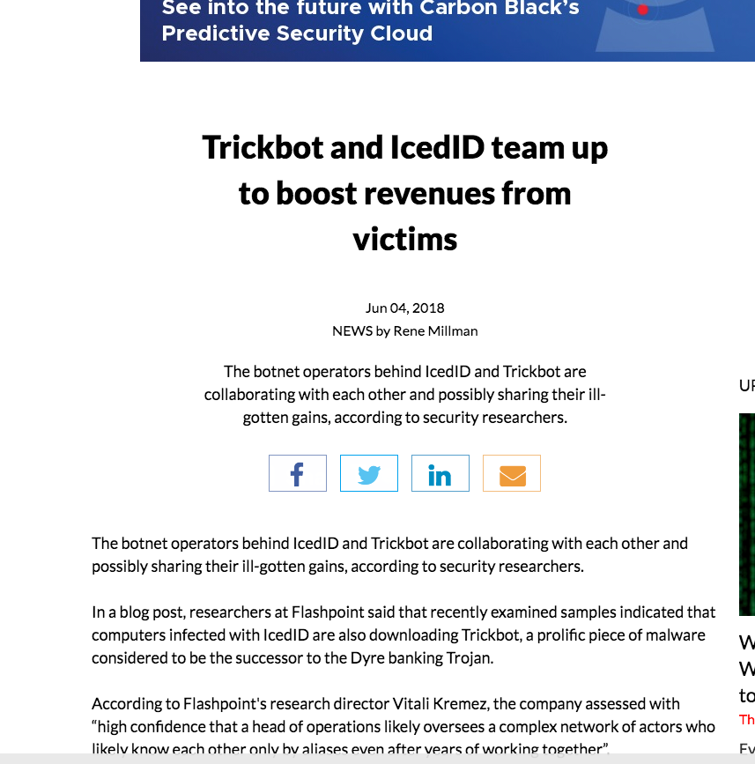
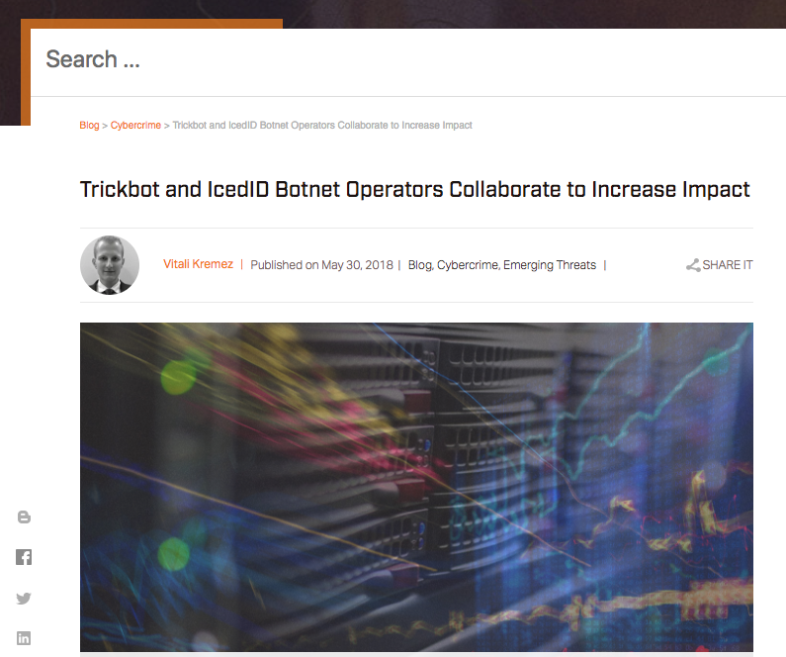
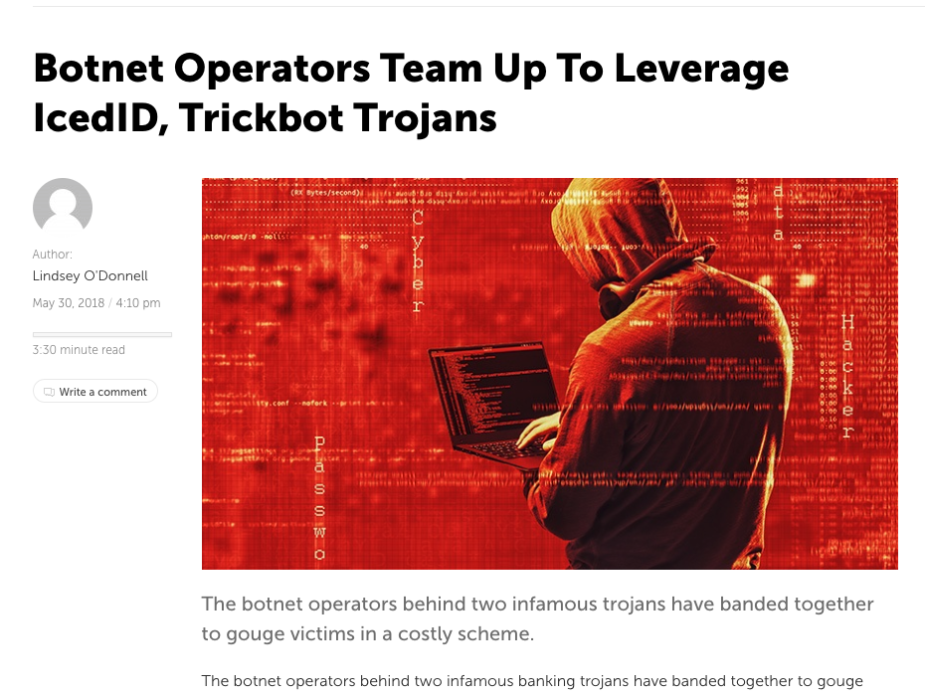

Slide 40
IcedID & TrickBot partnership
Both threat actors are since Late May/June been collaborating.
Both targeting banking victims in a dual threat and sharing profit.
Not working together on malware development (so far)
Working on an operational level.
Samples of IcedID have been recently seen pulling down TrickBot and installing it.
Dual threat can utilize:
TrickBot man-in-the-middle functionality
IcedID standout capability of using proxies to steal website information.

Slide 41
Malware Attack
How it works, why it’s so dangerous
Notes:
So I thought Id talk a small bit before I finish off about how such a malware attack can occur and how damaging this piece of malware is.

Slide 42
Attack Process Flow
Attacks target specific groups/nations.
Attacks can target certain banks the malware authors wish to exploit.
Normally they attack high income European countries like the UK and France and global nations like the US and Japan.
They use man-in-the-middle attacks exploiting webinjects.
These alter and replace content fields on the sites but make them still look and fell legit.
Once the victim puts in his/her credentials in the malware can steal this information
TrickBot uses both “web fakes” and “server side injecting ”
Notes:
So obviously we seen the file is dropped by a spam email but these attacks seem to be targeted groups of people. Be them a certain bank or nation.
- From looking at online stats it tends to be higher income EU countries, mostly the UK.
- They use man-in-the middle attacks exploiting webinjects.
- These can alter and replace legit banking websites to steal creds.
- This bot uses both web fakes and server side injecting

Slide 43
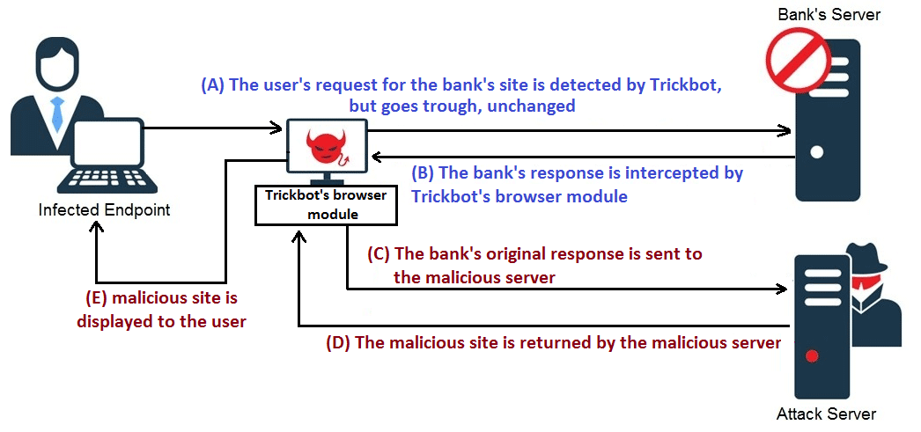
How it works
Diagram taken from Information Security Newspaper
Notes:
So I found this awesome diagram online of it that I thought i would show.
- So we see the user requests to the bank is detected by Trickbot.
- The banks responses are intercepted by the browser module, thus the man-in-the-middle attack has begone.
- The banks information and response is sent to the malicious server
- A fake malicious site is returned and then displayed to the user.
His/Her inputs stolen in the process.

Slide 44
Conclusion
The malware is extremely dangerous especially given its modular nature.
Banking trojan but with modules it can become extremely flexible, stealing what it can.
Main file has many anti-analysis tools and techniques.
Legit connection to the internet is needed.
No FakeNet and sandbox techniques will not work.
The malware is less then 24 months old and still developing.
The new modules can be dropped as malware develops and progresses.
Due to the increasing nature of online banking and e-commerce will only drive the threat actors to pursue this malware further.
Notes:
So to conclude.
Its extremely dangerous and damaging given its modular nature.
At heart it is a banking trojan but with its modular approach it can be extremely flexable.
- I was lucky to find the individual hashes as without them....this would have been a pretty short presentation.
- The malware itself is only about 2. years old and still developing.
- New module suggests a possible ransom feature in the future.
- Due to the growth of online banking, it will encourage the authors to keep working on it.

Slide 45
Thank you for listening
Any questions?

